Slide 1
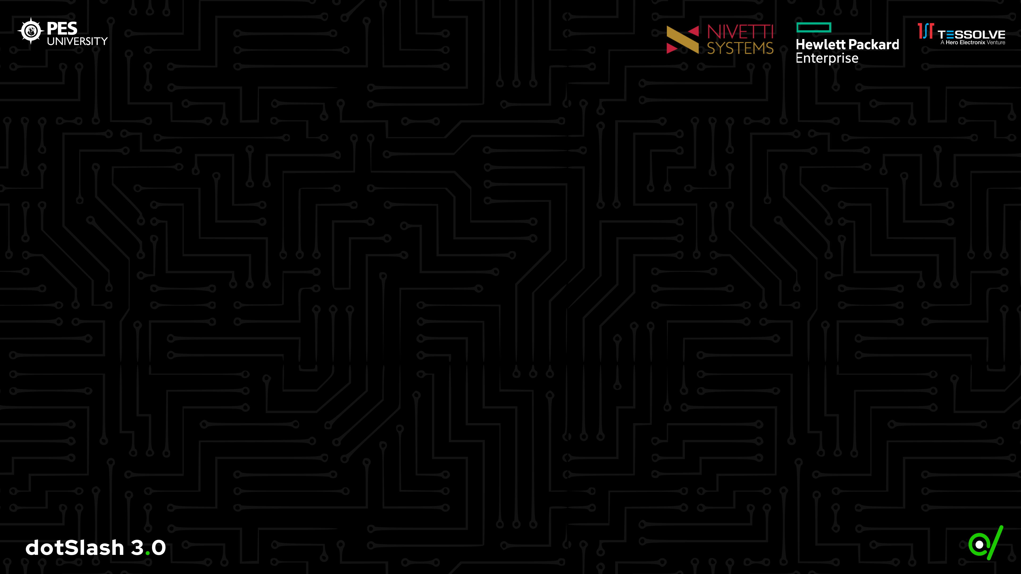
Finesse
Team Double Slash presents
Kshitij Saha
Thanushree R
K S Ramalakshmi
Shaarvari Kiran

Slide 2
0. Intro
Amateur investors usually venture into the market for passive income.
But they don’t have the time or expertise to pour through comprehensive financial reports in order to determine the returns of a stock
Presenting -> Stock market analysis and prediction using NLP
This NLP algorithm does the comprehensive analysis for them.

Slide 3
Problem Statement
New and amateur investors do not have the time or the expertise to pour over financial documents and get into the nitty gritties of company finance.
Making sense out of a web of different numbers and indices as a newbie investor can prove to be daunting
Professional investment managers gain an edge because of their expertise.

Slide 4
Proposed Solution
Enhanced Stock market Financial Analysis using NLP on 10-K Filings.
Technique Used:
Sentiment Analysis on 10-Ks
Loughran McDonald Sentiment Word Lists
Jaccard Similarity
TFIDF (Term Frequency-inverse document frequency)
Cosine Similarity

Slide 5
Proposed Solution
Objective of the mentioned solution:
To reduce human effort and error.
Simplify the task of deriving information about potential returns of stock indices by calculating Sharpe ratio by using NLP on annual financial reports(10 K annual filings).

Slide 6
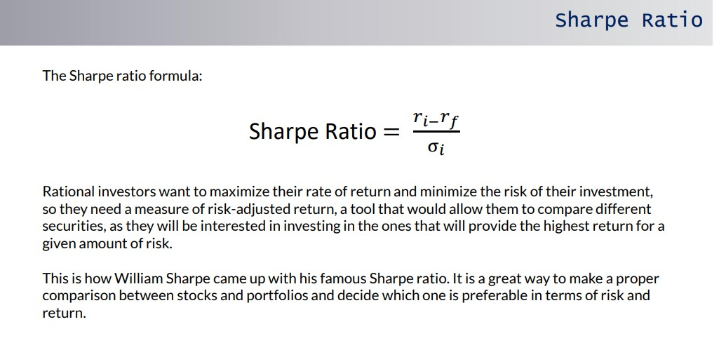
Sharpe Ratio

Slide 7
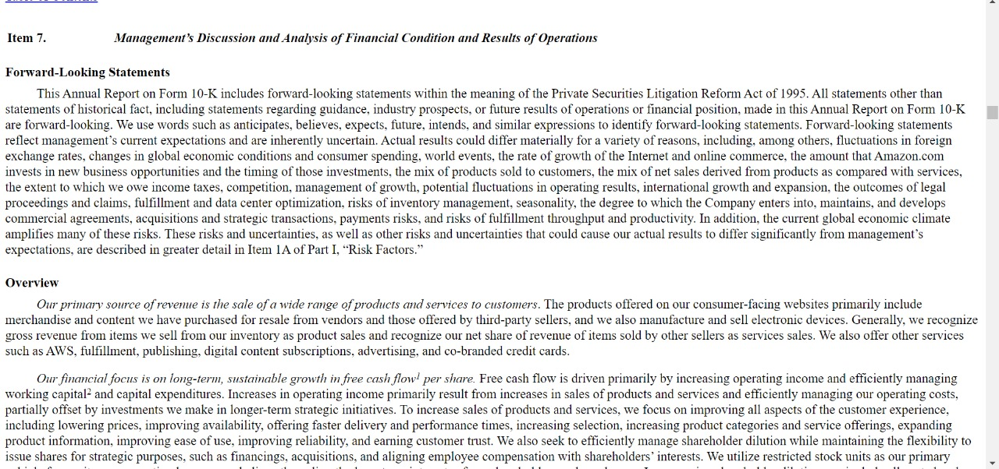
10-K Filing Report

Slide 8
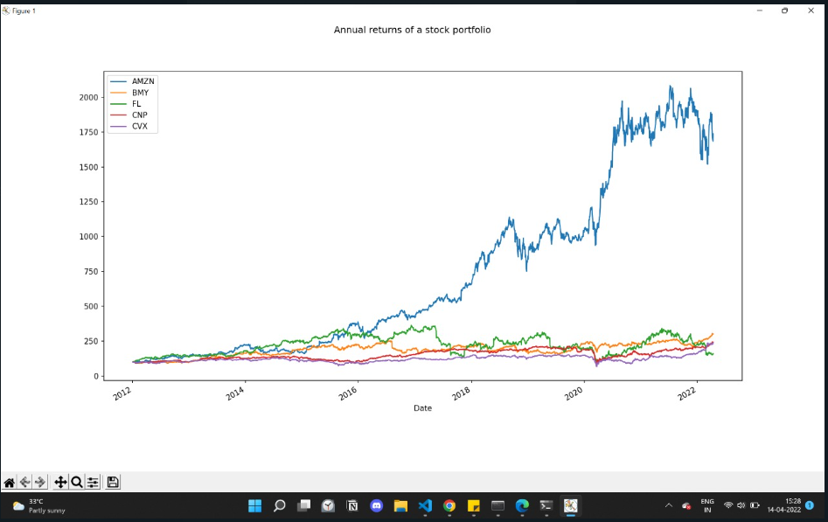

Slide 9
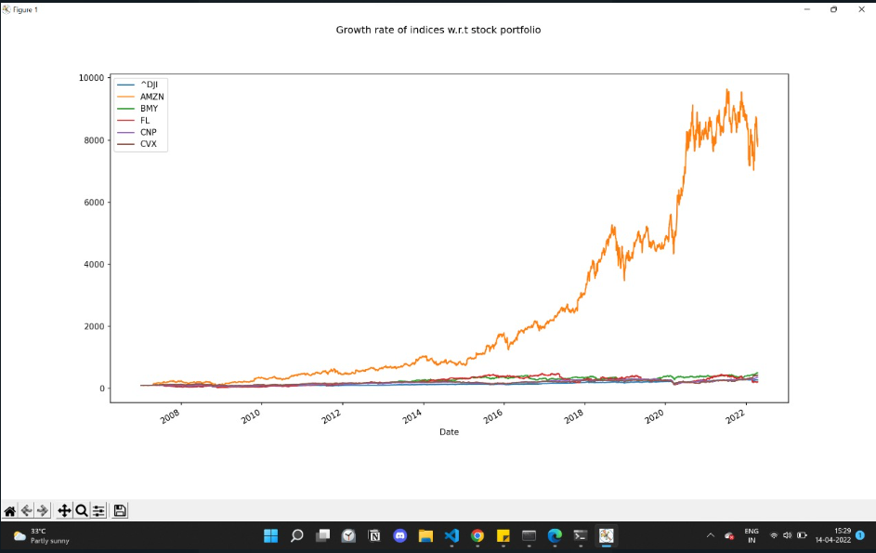

Slide 10
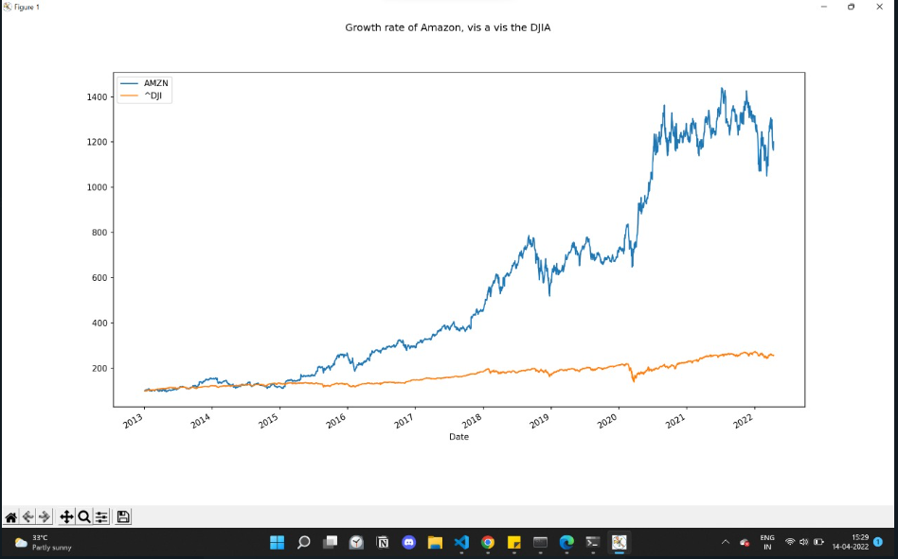

Slide 11
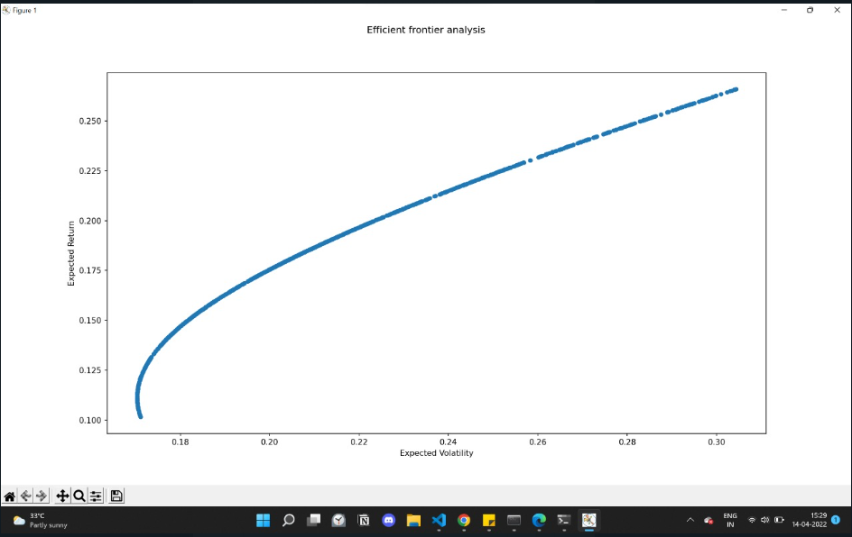

Slide 12
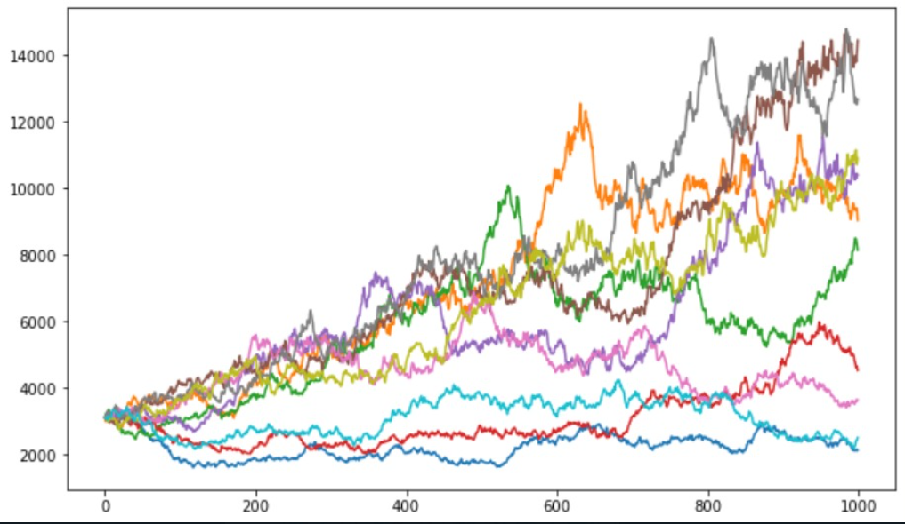

Slide 13
Feasibility
Will the target audience be able to use it?
Yes, amateur investors will be able to analyze a multivariate portfolio of stocks and analyze future risk and return ratios.
Is the solution important to the target audience? Would they be willing to adopt the solution?
Yes, considering the increase in new investors in stock market, more and more people want to begin investing in securities and this makes it easier for them to begin.

Slide 14
Future Scopefinancial algorithms
Integration of the Vader Sentiment Analysis score of current affairs.
This can more accurately predict the rise or fall of company stocks.
Needs mathematical research to manipulate existing financial algorithms

Slide 15
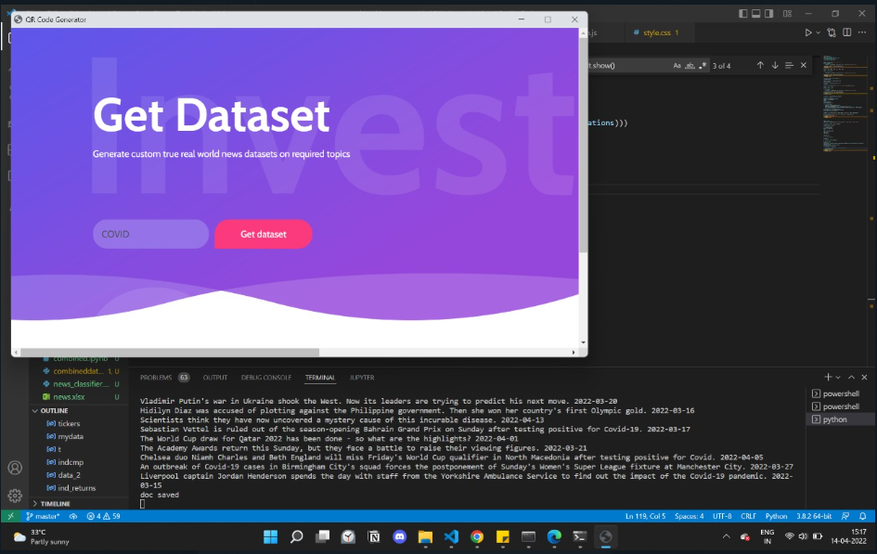
Custom dataset generator

Slide 16
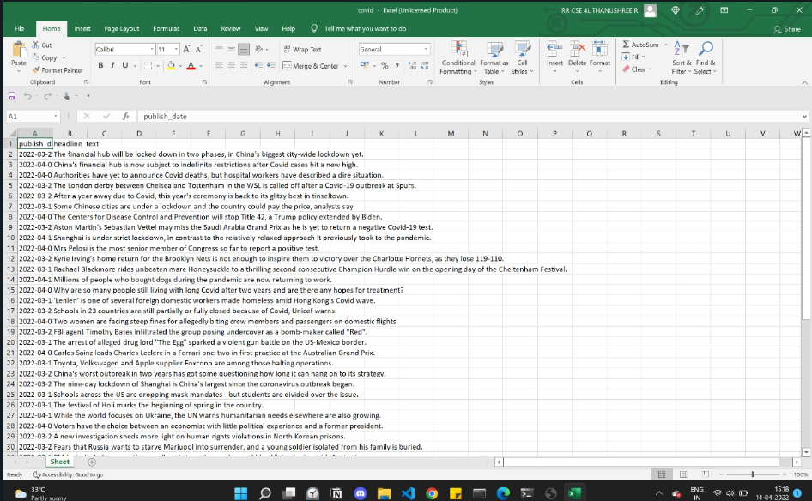
Generated Dataset

Slide 17
Tools used
NLTK
Numpy
Pandas
Pickle
PPrint
Vader sentiment analysis
OpenPyXl
Python EEL
HTML, CSS, JavaScript

Slide 18
